Slide 1
My Performance – Overview of the System
What is it?
My Performance is a complete Performance Management System designed to drive us towards the achievement of our Vision and support all Scapa managers with establishing, recording, and tracking annual performance and development objectives.
Via automated on-line workflow and e-mail technology, you will be guided through all steps in the annual performance review process.

Slide 2
How is this better for you?
Allows you to participate in setting expectations – right from the start. You the employee drive the process
Provides clear outline for your areas of focus and supports timely and regular feedback
Improves communication with your manager and teams
Defines opportunities for development
Creates a clear understanding of how you are evaluated
Secure on line system provides central location to manage and store objectives and performance review forms
Help for Managers in writing reviews via tools such as Coaching Advisor and Legal Scan
Access via the Scapa Intranet

Slide 3





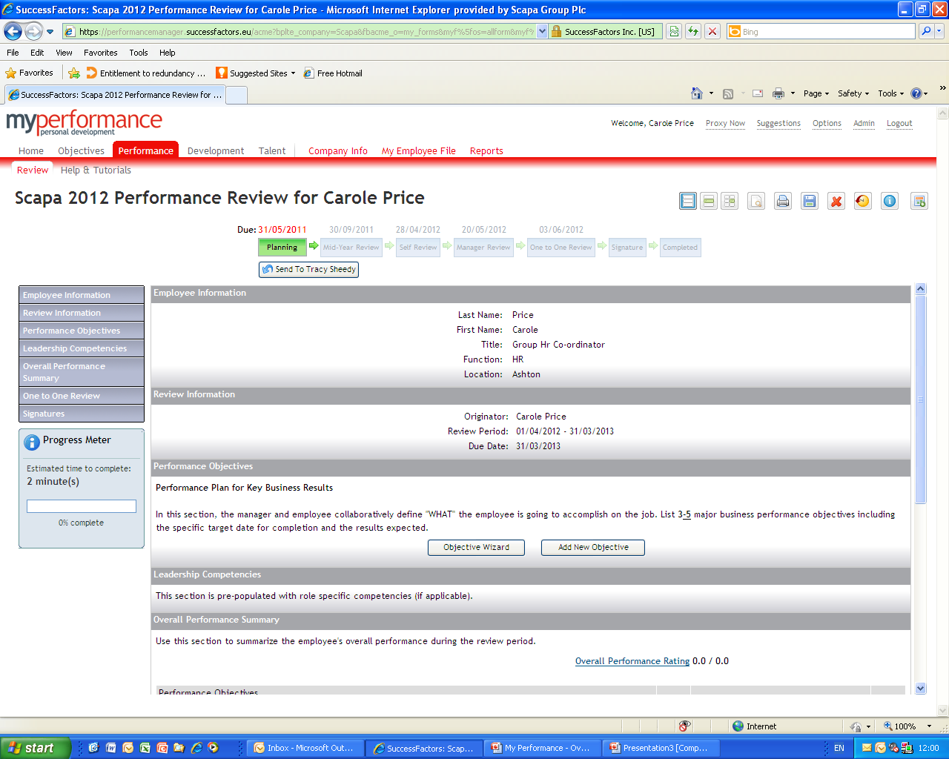
Workflow and Performance Review Process
A Performance Management Form is automatically routed to your inbox indicating what action is required. Below is the route map indicating the electronic actions. Current step will be highlighted in green
Planning step – log into the system and access your Objectives plan, define objectives for the review period that you consider most appropriate for your job role. Objectives created are automatically uploaded to your Scapa 2009 Performance Review Form. Once created you will trigger the workflow by sending them to your manager for review and agreement. In addition, you will also create your development plan using information from your 360 feedback. Objectives can be reviewed/updated at any stage by you or your manager
Mid Year Review step – a mid year checkpoint between you and your manager to discuss progress, update priorities and identify areas for development for the rest of the year. Log into the system and access your Performance Review Form in the Performance Tab. Comment on your progress to date and provide specific examples, where possible. Save your work and send it to your Manager by clicking the send to… button at the top of the screen. The form is routed to your manager who updates the Performance Review Form with feedback. Your manager completes the mid year review and routes to year end which returns to your Performance inbox.
Year End Review step consists of 3 parts: Self Review, Mgr review & One to One review. Log into the system and access your Performance Review Form in the Performance Tab. Rate your performance and competencies and give examples where possible. Save your work and send the form to your Manager. The form is routed to your manager who reviews your input and enters performance comments, objective and competency ratings. You and your manager will then arrange to have a one to one review session. You will also review your Development Plan during this meeting and update your Plan, as appropriate. After this your manager clicks ’Send to Employee for signature’ button to acknowledge the review has been completed
Signature Step - to complete the review you will click the ‘signature’ button at the top of the screen to indicate that the year end review has been completed and that you acknowledge the feedback on the Performance Form; or you may click ‘Decline’ button and comments on your reasons and request additional discussion regarding the feedback on the form. Once you have signed the form, it will be routed to your manager for signature. The signature comments field is final and not an interative step between you and your manager
Completed – All Completed forms are stored in your completed box under unfiled. You should create and maintain folders to organise your completed. You and your manager will receive a copy of the form in their inbox for filing.

Slide 4
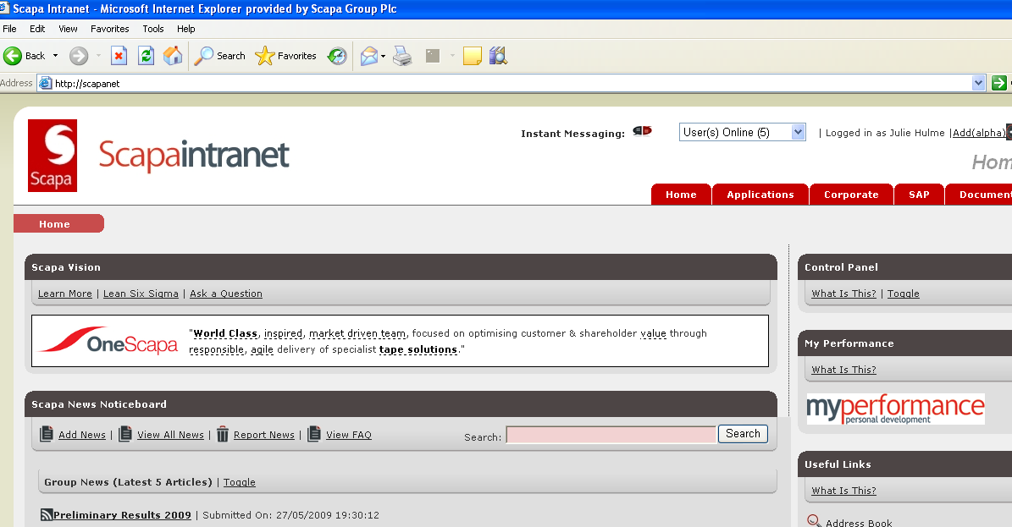
Getting started is Easy!
You can simply access the system via the Scapa Intranet: http://scapanet/
Click here to access your
personalised log on screen.
You will receive automated notification when you need to participate in the process

Slide 5
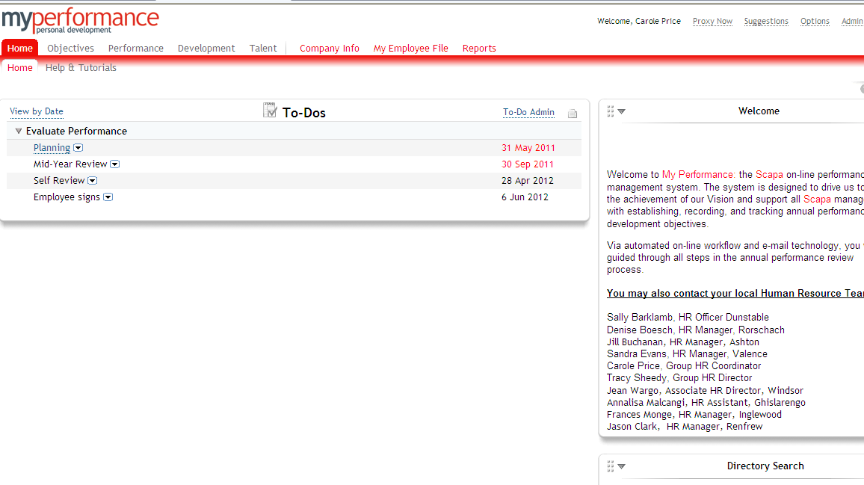
Exploring your My Performance Personalised Home page
Provides a list of current forms that require action. The current stage will indicated by a green tick
Click here to send an email query to HR Team
Search facility – type in name of employee you are trying to find

Slide 6

Home Page - Location tabs
The system consists of the following location tabs.
Click on the required tab. Current location tab is highlighted in red
There is a 30 minute timeout on the system, ensure
you save your work regularly

